Slide 1



CAPSTONE PROJECT
My College - ChatBot
Presented By:
Vatsal Sharma

Slide 2
OUTLINE
Problem Statement
Proposed System/Solution
System Development Approach
Result
Conclusion
Future Scope
References

Slide 3
Problem Statement
Challenges in streamlining the college admission process for prospective students.
Need for a user-friendly and efficient system to provide accurate information and guidance.

Slide 4
Proposed Solution
User Interaction: Engages users in natural language conversations, guiding them through the admission process.
Information Collection: Securely gathers essential user data such as name, contact details, exam scores, and course preferences.
Query Handling: Responds promptly and accurately to inquiries about course details, admission criteria, application status, and general college information.
User Guidance: Offers step-by-step assistance on completing applications, submission deadlines, and required documentation.
Feedback Mechanism: Incorporates user feedback to continuously improve response accuracy and user satisfaction.

Slide 5
System Approach
Technology Used: IBM Watson Assistant for natural language processing and dialog management.
System Requirements: Compatible with modern web browsers and mobile devices.

Slide 6
Result
Developed a college admission chatbot aimed at simplifying and enhancing the application process for prospective students.
Facilitates intuitive and efficient interaction through natural language processing capabilities.
Ensures secure and confidential handling of user data throughout the application journey.
Enhances user experience by providing timely and accurate information tailored to individual queries.
Feedback mechanism enables ongoing refinement of chatbot responses based on user interactions.

Slide 7
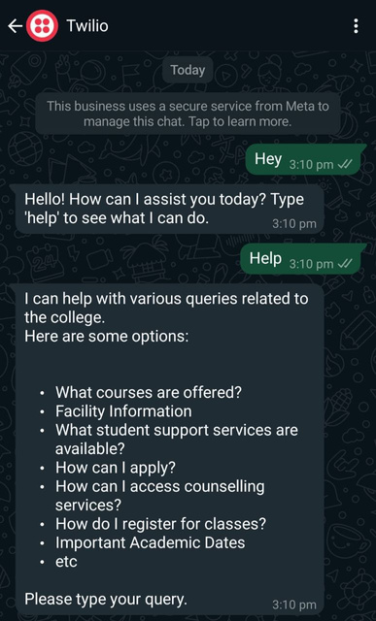
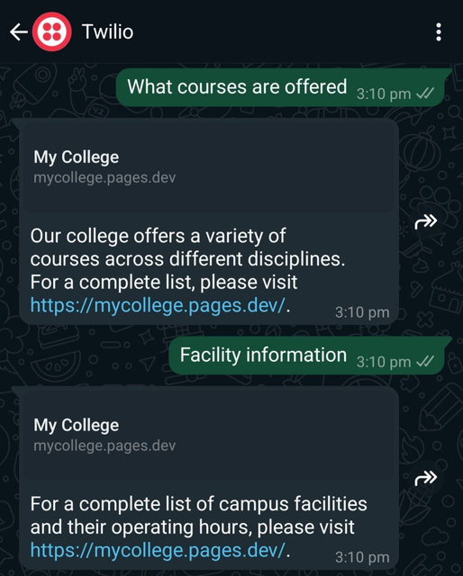
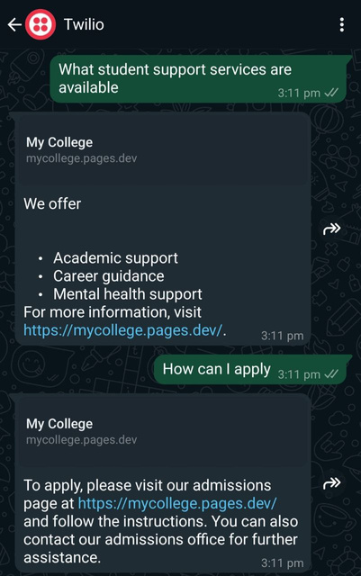
Result

Slide 8
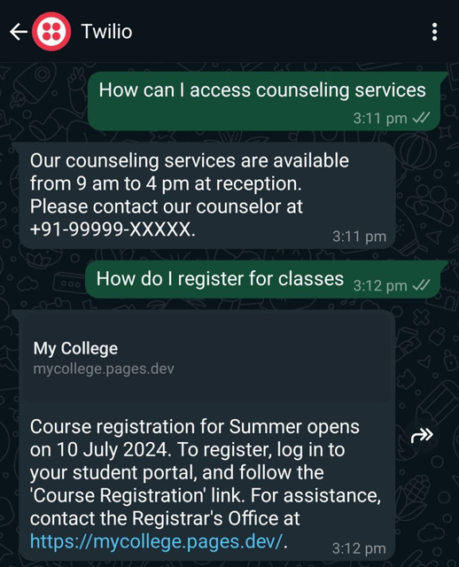
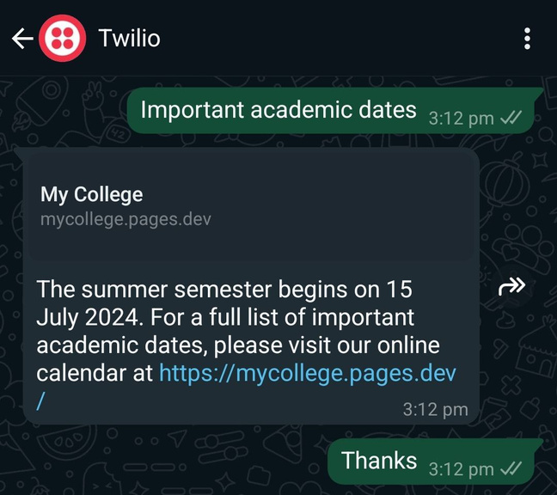
Result

Slide 9

Project Link
https://github.com/Vatsal-Sharma2003/IBM-edunet-SkillsBuild-Internship-Project

Slide 10
Conclusion
The college admission chatbot represents a significant advancement in improving accessibility and user experience in the admission process.
By leveraging AI-powered natural language processing, it effectively addresses the informational needs of prospective students.
Offers a scalable solution to accommodate future enhancements and adapt to evolving user requirements.
Contributes to a streamlined and efficient admission process that benefits both applicants and the institution.

Slide 11
Future scope
Personalized Assistance: Implement machine learning algorithms to offer personalized recommendations and adaptive guidance.
Multilingual Support: Integrate language translation capabilities to cater to diverse applicant demographics.
Enhanced Features: Incorporate virtual campus tours, interactive FAQs, and real-time application status updates.

Slide 12
References
IBM watsonx Assistant tutorial

Slide 13
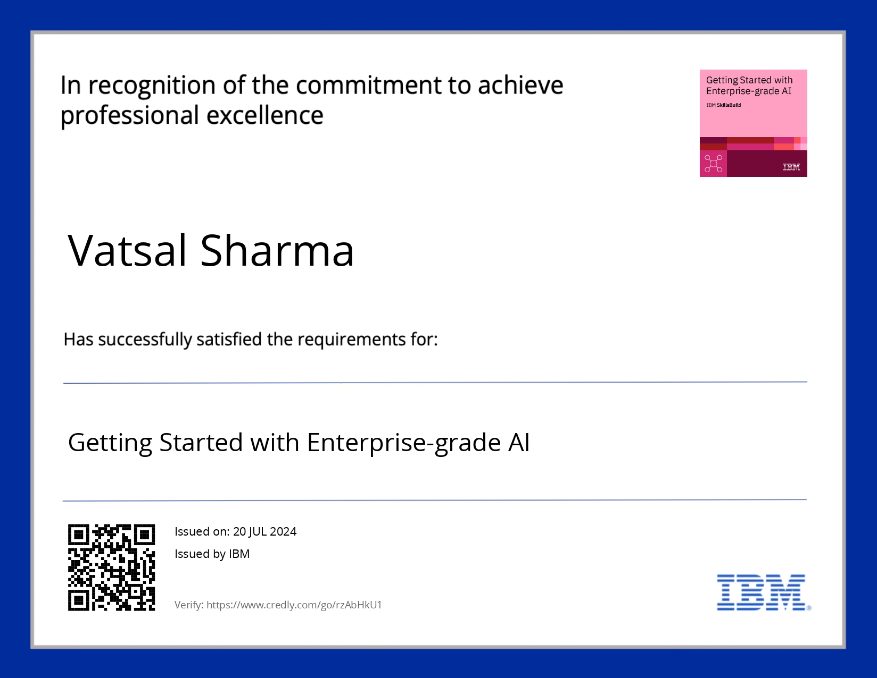
course certificate 1

Slide 14

course certificate 2

Slide 15
THANK YOU

